Slide 1
Happy Rapid Cart

Slide 2
Hello!
We're Jasmine & Maria
DePaul University & New College of Florida
z
We built an enhanced grocery delivery app
The global e-commerce market is expected to grow at a compound annual growth rate of 14.7% from 2020 to 2027
Notes:
Hi everyone! Happy Rapid Cart is a groceries delivery app that makes shopping a more easier, effective, personalized, and fun process. We are Jasmine and Maria. We built this app..Why this is important? Because f the market size .The global e-commerce market is expected to grow at a compound annual growth rate of 14.7% from 2020 to 2027 to reach USD 27,147.9 billion by 2027.

Slide 3
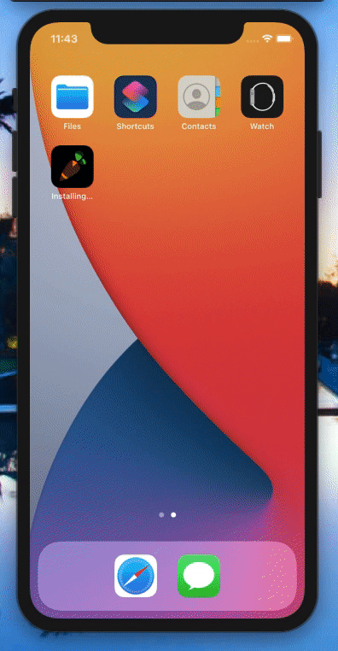
1.
User User User Login
Notes:
Our app first has the user sign up or login. Their credentials are saved via an API call to our Parse cloud database.
Additionally, we use local persistence to preserve the session so the user remains logged in even if they close the app.

Slide 4

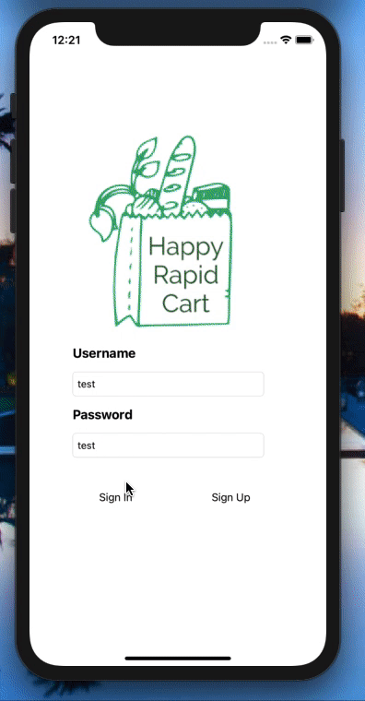
2.
Find Stores & Purchase
Notes:
The user can see stores within a 10 mile radius of them and then choose a store.
They'll proceed to pick items and add them to their cart.
Both the REAL stores and REAL products shown come from 2 separate, external API calls that populate all the information on the screen.
None of this is hardcoded.
_____
For the technical aspect we used to APIs. One for the stores where we send the location in the form of longitude and latitude and then get a list of all the nearby stores within a radius of 10 miles. Then we us the API response to populate the list of stores in the app.
The user can search any products that are available in the selected nearby store and add it to the cart.
For the technical part we used an API that returns a list of products based on a search term. For each product the api returns an product’s name, image, quantity, and price. The user can add any product to their cart and then navigate to their cart from the top right button.

Slide 5
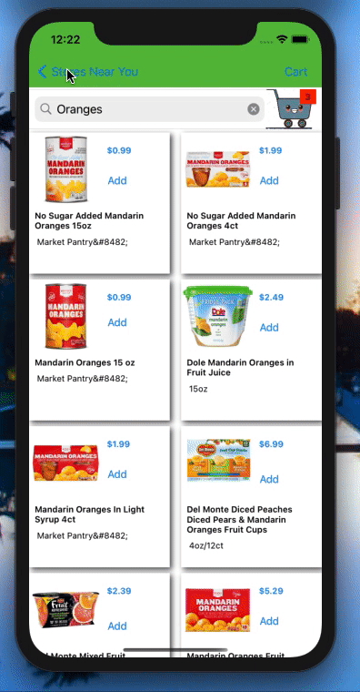
3.
Search to promote personalization
Finding stores that carry a certain recipe should be easy!
This aids quick access and lessens churn.
Notes:
Lastly, we help the user narrow down the number of stores by a certain recipe they are looking for. This help guarantee that the user can quickly find the items they need. Lasly, this helps prevent user churn, which could occur because a user has to manually keep checking stores that don't have the items they need.

Slide 6
Future Features
Cost splitting between friends
Personalized Cart image
Products fly to cart animation
Promote recipes during holiday times to onboard users to the personalization feature
Notes:
We believe the user experience is what differentiate a good app from a great app.
We wanted to make the app more fun, so adding a fly to cart animation will resemble the real life shopping experience for the use. Allowing the user to message their friends if they want to add to the same order and splitting the delivery fee to make it more affordable for people. Changing the cart happy face to be the user’s face to make it a more personalized process.

Slide 7

Thank you!
Any questions?
Our GitHub: https://github.com/Happy-Rapid-Cart/Instacart2020/
Notes:
Path forward: -instacart gets its data from disparate sources including API calls and data pipelines that may contain CSV files or spreadsheets.
What Instacart could do is join this data between all stores and compare the resulting "product catalog" with customer cart and order data.
Find which products are routinely purchased at a high frequency and which are suited for recipes. Then instacart could release recipe inspiration prompts to the user to help guide their searching. Then that could help the user filter down to stores that they are interested in.

Slide 8
Credits
Special thanks to all the people who made and released these awesome resources for free:
Presentation template by SlidesCarnival
Photographs by Unsplash

Slide 9
Appendix: Core Features
local memory (userdefault dictionary, keeps the person logged in)
Parse to save user login and store their cart
user can search for products
two APIs called to fetch stores and items
user picks a store
(hopefully) user can either pick a recipe or item to them see stores that sell it
or user picks a store and buys food
adds to cart
animation (tbd)

